Slide 1

Heart Disease Analysis
Data Driven insights for public health recommendations
Presented By:
Nora Raafat
Eman Ayman
Abdelrahman Gamal

Slide 2

Content
Introduction
Collecting Data & Overview
Data Cleaning & Feature Engineering
Data Diagnosing
Explatory Data Analysis (EDA)
Data Visualization (Three Dashboards)
Key Insights
Conclusion
Recommendations

Slide 3

Introduction To Heart Disease

Slide 4
Introduction
This analysis examines various factors associated with heart disease among individuals in the US.
Analysis Focus
Analyzing a dataset that includes extensive health and lifestyle data of individuals at risk for Heart Disease.
Objective
Performing comprehensive EDA and statistical testing
To identify and quantify the key demographic, clinical, and lifestyle risk factors linked to heart disease and stroke
To translate the findings into actionable recommendations for healthcare policy and patient awareness.

Slide 5

Collecting Data & Overview

Slide 6
Data Overview
Source : Kaggle (4238 row, 16 col).
Feature Type | Example Features | Role In Analysis
Demographic/Lifestyle | Gender, age, education, currentSmoker, cigsPerDay | Analyze prevalence across different groups.
Medical History | BPMeds, prevalentStroke, prevalentHyp, diabetes | Measure association strength with the target event.
Clinical Measurements | totChol, sysBP, diaBP, BMI, heartRate, glucose | Determine critical thresholds and statistical differences between 'Yes' and 'No' groups.
Target Variable | Heart_ stroke (Binary: Yes/No) | The primary variable for testing.

Slide 7

Data Cleaning & Feature Engineering

Slide 8


Data Cleaning & Feature Engineering
Replace Binary With Text in Col.
[currentSmoker’,‘BPMeds’,’prevalentHyp’,‘diabetes’]

Slide 9

Data Cleaning & Feature Engineering
Missing values were handled using :
Mode For Categorical Feature [education] , [BPMeds] .

Slide 10




Data Cleaning & Feature Engineering
Median For Numerical ([cigsPerDay], [totChol], [BMI], [heartrate], [glucose]).

Slide 11



Data Cleaning & Feature Engineering
Feature Engineering We add 9 new categorical features for deeper analysis and categorization: (Chol_Cat, Glucose_Cat, HeartRate_Cat).

Slide 12



Data Cleaning & Feature Engineering
Categorize Col.(age_group, BMI_Cat, Cigs_Range)

Slide 13



Data Cleaning & Feature Engineering
Categorize Col. (sys_Cat, Dia_Cat, BP_Cat)

Slide 14


Data Cleaning & Feature Engineering
Check Duplicates & White Spaces

Slide 15


Data Cleaning & Feature Engineering
Convert Data Type :
‘BPMeds’ into “Object”,
‘cigsPerDay’ into “int”

Slide 16

Data Cleaning & Feature Engineering
Standardize categorical Values :

Slide 17

Data Diagnosing

Slide 18
Data Diagnosing
Extreme/Abnormal Values
Glucose
262
sysBP
126
totChol
57
BMI
97
cigsPerDay
12
Max 394
Diabetic-range hyperglycemia
Max 295 hypertensive crisis level
Max 696
Critically elevated
Max 56.8
Severe obesity
Up to 70 Heavy smoking behavior
These values reflect real but clinically abnormal cases and were retained for risk analysis with controlled preprocessing

Slide 19
Data Diagnosing
Defining the Critical High-Risk Profile
Age >= 50
BP >= Hypertension Stage 1
Diabetes = YES
OR
History Of Stroke = YES
High Risk
‘Tripple Threat Profile’
This profile combines the most statistically significant demographic and clinical risk factors, making it the highest-impact target for reducing future heart disease and stroke events.

Slide 20

Explatory Data Analysis

Slide 21
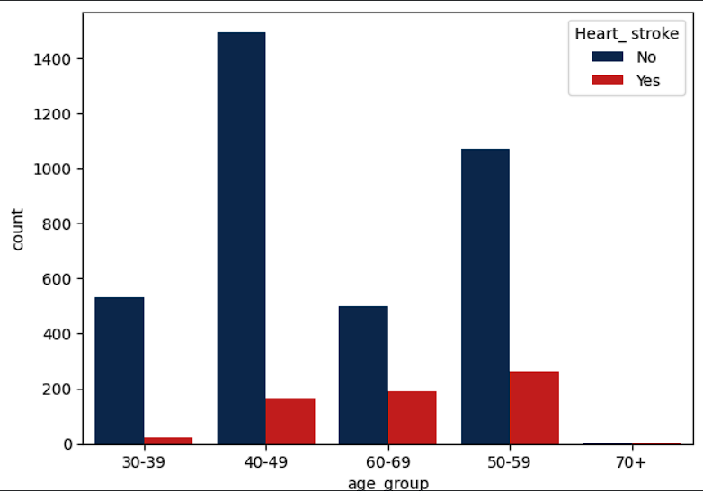
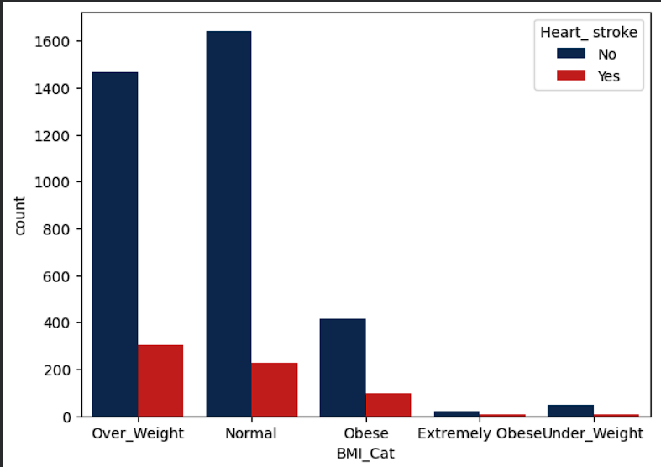
Explatory Data analysis (insights)
Age & metabolic Indicators
Age is the strongest driver: The risk of stroke increase significantly, with the highest prevalence found in the 50-59 (1333 individuals) and 60-69 (688 individuals) age groups
The more wight to gain the greater your risk of heart disease

Slide 22
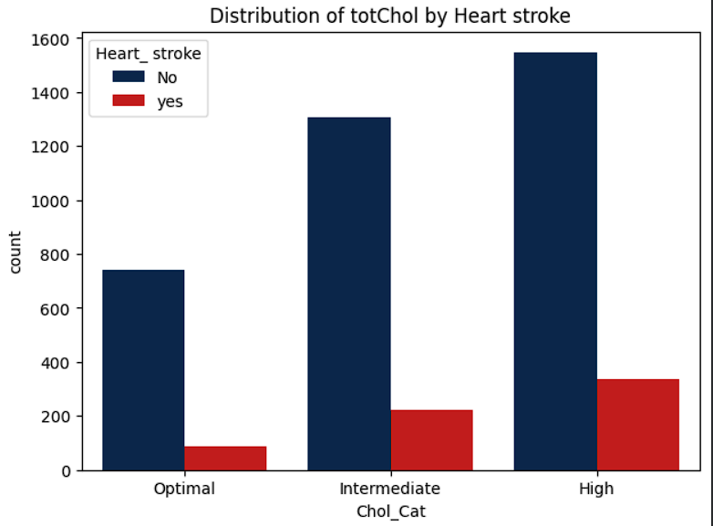
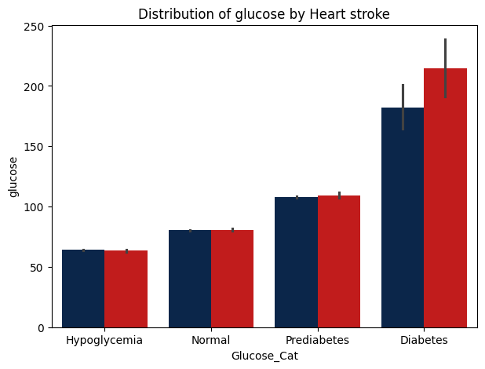
Explatory Data Analysis (insights)
Analyze The Impact Of Cholesterol & Glucose
Patients who had a stroke event generally had higher average blood sugar levels across all groups. This proves that keeping your glucose under control is very important for preventing heart problems.
Heart stroke cases increase as cholesterol levels rise, with the highest risk observed in individuals with high cholesterol.

Slide 23
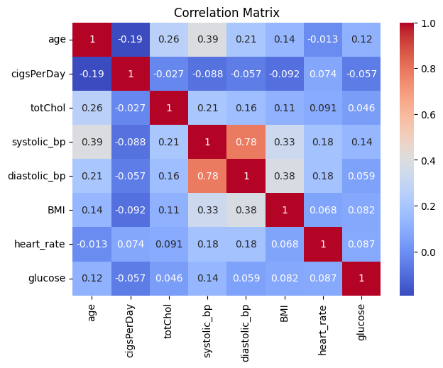
Explatory Data Analysis (insights)
Correlation Analysis of Clinical Risk Factors
Blood pressure—particularly the strong link between systolic and diastolic measures—is the most interrelated risk factor, while other variables contribute largely independent cardiovascular risk.

Slide 24

Data Visualization

Slide 25
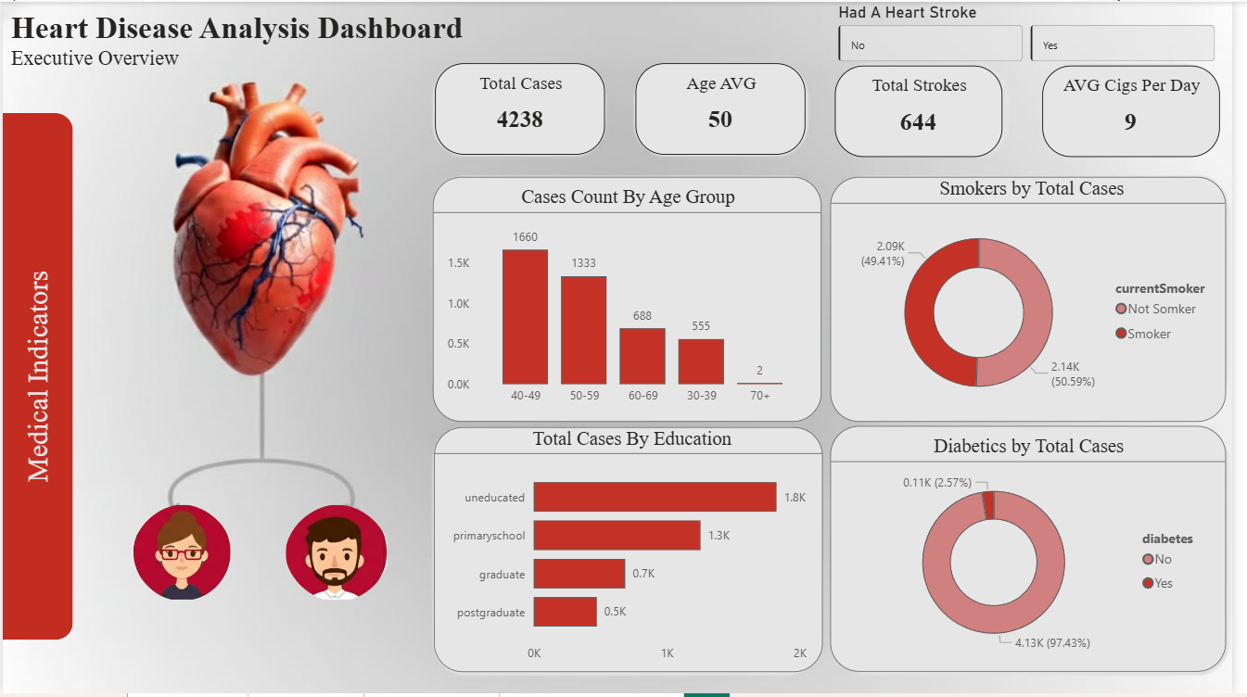
Interactive Dashboard (Power BI) Demonstration

Slide 26

Key Insights
High-Risk Core: 4,238 total cases(Avg. Age: 50) 15% (644 people) have already suffered a stroke.
The "Danger Zone": Risk peaks between ages 40–59, accounting for the vast majority of cases.
Lifestyle Impact: 51% are smokers, averaging 9 cigarettes per day, making smoking a primary modifiable risk factor.
The Education Gap: Cases are highest among uneducated/primary-school groups and decrease sharply as education levels rise.
Executive Insights: Heart Disease Risk Analysis

Slide 27
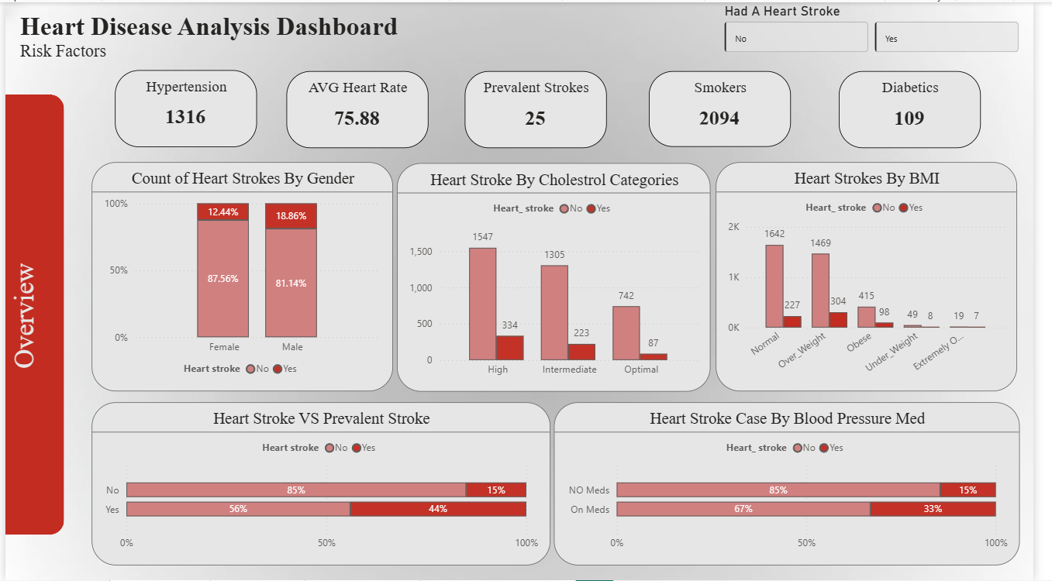
Interactive dashboard 2

Slide 28

Key Insights
Hypertension and smoking are dominant risk factors (1,316 hypertensive cases; 2,094 smokers).
Men have higher stroke prevalence than women (18.9% vs. 12.4%).
High cholesterol and elevated BMI are strongly linked to stroke incidence, with overweight individuals showing the highest counts
Prior stroke history is the strongest predictor (44% vs. 15% without prior stroke).
Patients on BP medication show higher stroke rates, reflecting greater underlying risk severity.
Clinical Risk Factors & Stroke Correlation

Slide 29
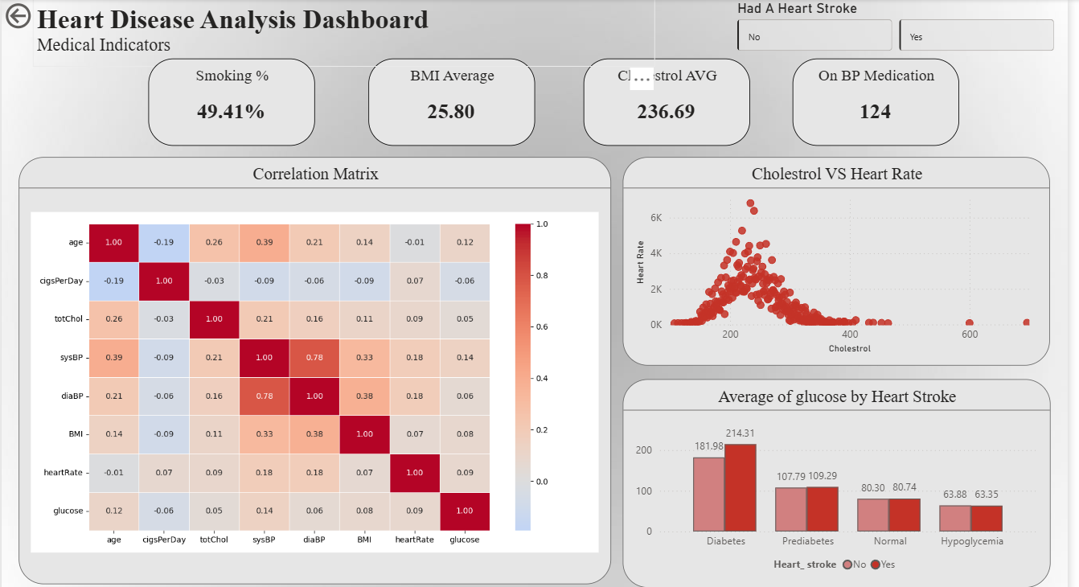
Interactive Dashboard 3

Slide 30
Key Insights
Primary Risk Factor (Blood Pressure): There is a strong positive correlation (0.78) between Systolic and Diastolic Blood Pressure, identifying hypertension as a central medical indicator in this group.
Diabetes-Stroke Link: Average glucose levels are highest among stroke victims (214.3 mg/dL). The risk of stroke increases significantly as patients move from "Normal" to "Diabetes" glucose ranges.
High Smoking Prevalence: Nearly half of the population (49.4%) are smokers, representing a major modifiable lifestyle risk factor.
Weight & Age Trends: The average BMI (25.8) indicates an overweight population baseline. Correlation data shows that as Age increases, both blood pressure and cholesterol levels tend to rise.
Clinical Indicators & Statistical Risk

Slide 31
Conclusions : Integrated Risk Profile
Conclusion
The analysis reveals that Heart disease (Stroke) risk in this population is not driven by a single factor, but by a combination of age, lifestyle choices, medication and clinical factors.
Primary Demographic: Adults aged 40–59 are at the highest risk, particularly those with lower education levels.
Most Dangerous Predictors: A history of prevalent strokes (44% risk) and High Cholesterol are the most significant clinical red flags.
The Silent Driver: While smoking is a major modifiable risk, Systolic Blood Pressure shows the strongest statistical correlation with aging and clinical severity.

Slide 32
Actionable Recommendations
Recommendations
Expand Screening: Target individuals in their 40s with high cholesterol or those already on BP medication. Provide mandatory, low-cost blood pressure and glucose checks for everyone aged 50 and above.
Target High-Risk Smokers: Focus smoking cessation programs on individuals who already have high blood pressure.
Strengthen Awareness: Educate overweight individuals and those with high cholesterol to prevent progression to severe cardiovascular risk.

Slide 33
Thank you for your attention
Any Question's?

